Slide 1
Enumeration
Lecture 6

Slide 2
Enumeration Type
Data type: a set of values together with a set of operations on those values
To define a new simple data type, called enumeration type, we need three things:
A name for the data type
A set of values for the data type
A set of operations on the values
C++ Programming: From Problem Analysis to Program Design, Fourth Edition
‹#›

Slide 3

Enumeration Type (continued)
A new simple data type can be defined by specifying its name and the values, but not the operations
The values must be identifiers
Syntax:
value1, value2, … are identifiers called enumerators
value1 < value2 < value3 <...
C++ Programming: From Problem Analysis to Program Design, Fourth Edition
‹#›

Slide 4
Enumeration Type (continued)
Enumeration type is an ordered set of values
If a value has been used in one enumeration type it can’t be used by another in same block
The same rules apply to enumeration types declared outside of any blocks
C++ Programming: From Problem Analysis to Program Design, Fourth Edition
‹#›

Slide 5
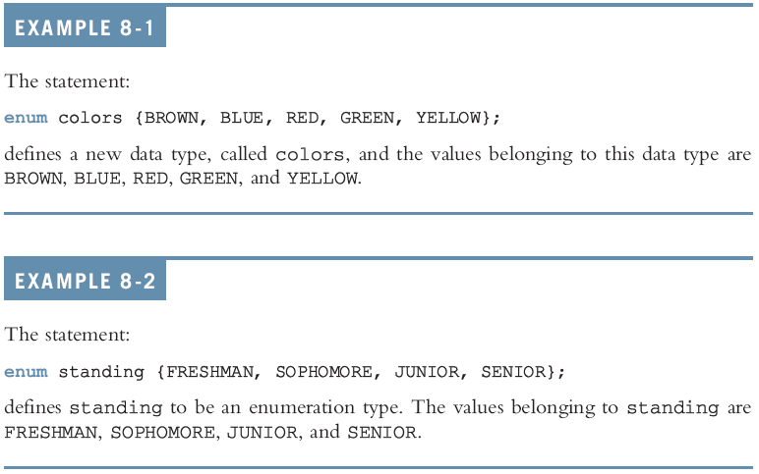
Enumeration Type (continued)
C++ Programming: From Problem Analysis to Program Design, Fourth Edition
‹#›

Slide 6
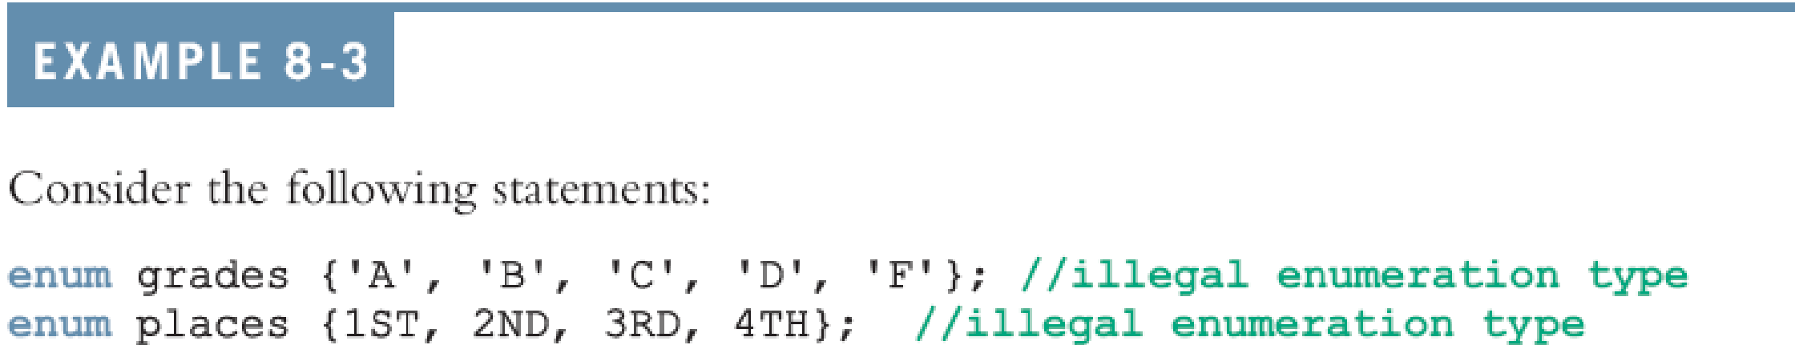
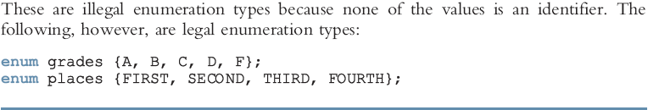
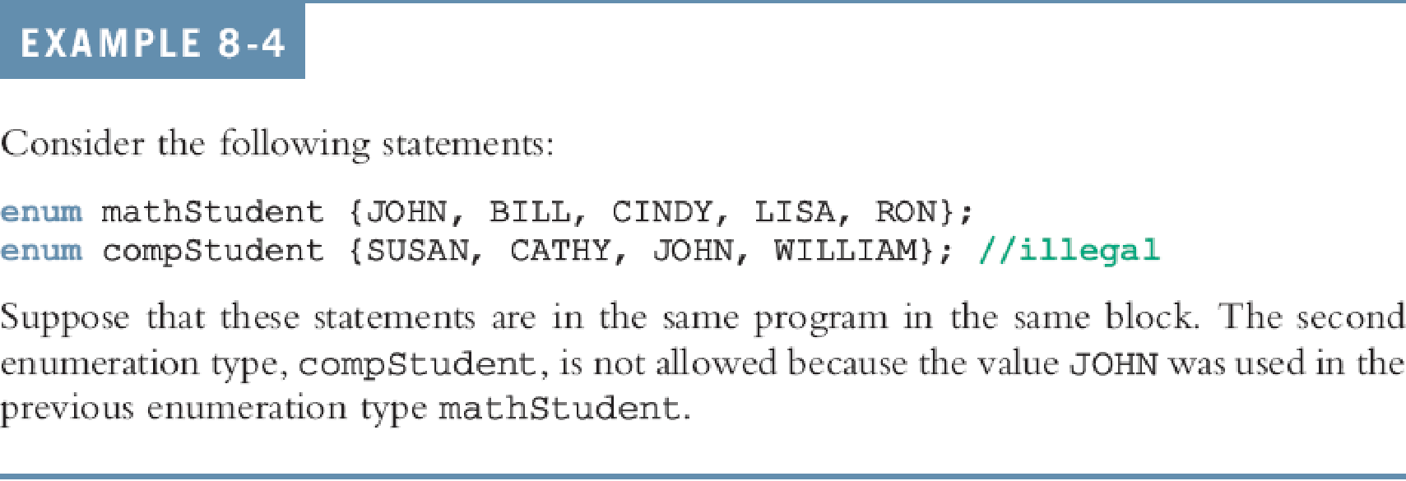

Slide 7

Declaring Variables
Syntax:
For example, given the following definition:
we can declare the following variables:
C++ Programming: From Problem Analysis to Program Design, Fourth Edition
‹#›

Slide 8
Assignment
The statement:
popularSport = FOOTBALL;
stores FOOTBALL into popularSport
The statement:
mySport = popularSport;
copies the value of the popularSport into mySport
C++ Programming: From Problem Analysis to Program Design, Fourth Edition
‹#›

Slide 9
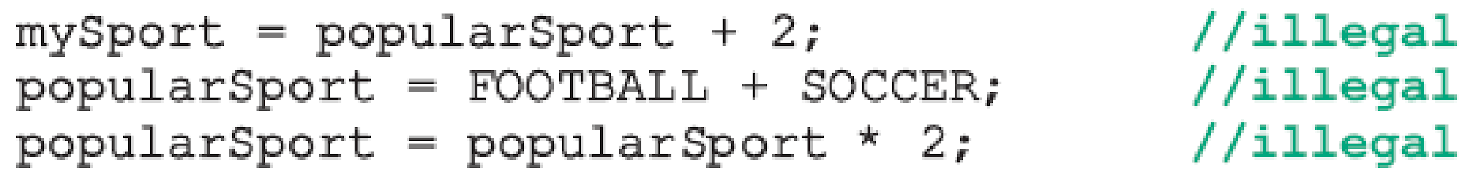

Operations on Enumeration Types
No arithmetic operations are allowed on enumeration types
++ and -- are illegal too:
Solution: use a static cast:
C++ Programming: From Problem Analysis to Program Design, Fourth Edition
‹#›

Slide 10
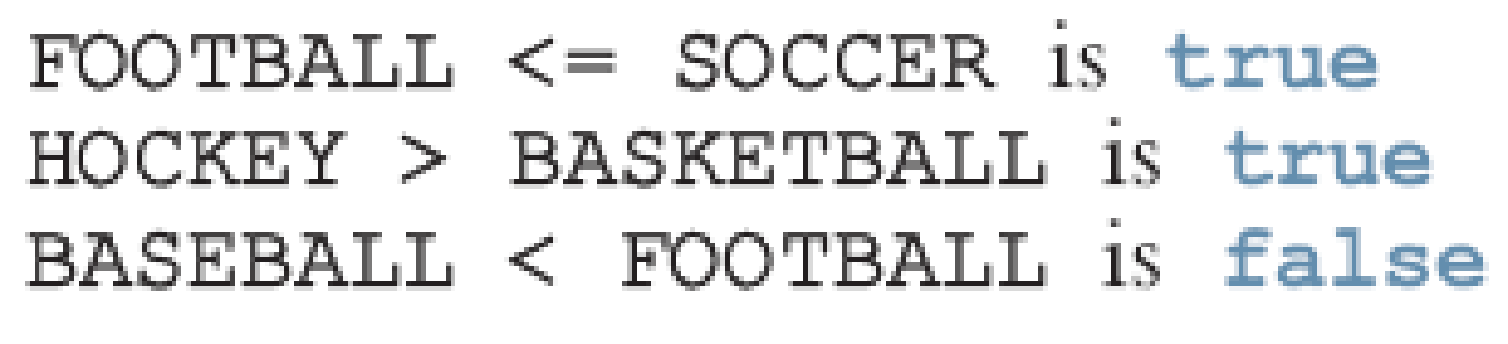
Relational Operators
An enumeration type is an ordered set of values:
Enumeration type is an integer data type and can be used in loops:
C++ Programming: From Problem Analysis to Program Design, Fourth Edition
‹#›

Slide 11
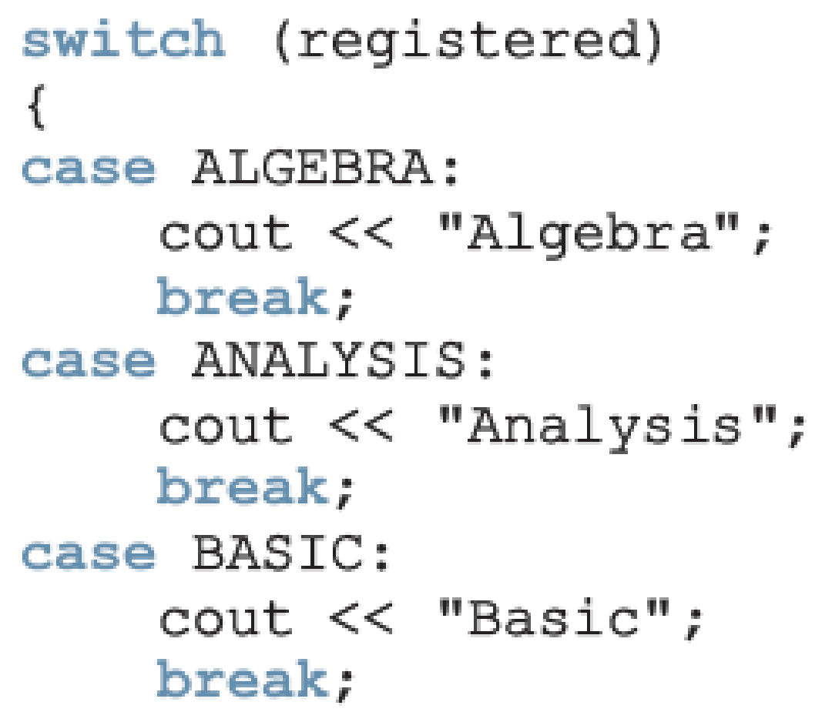
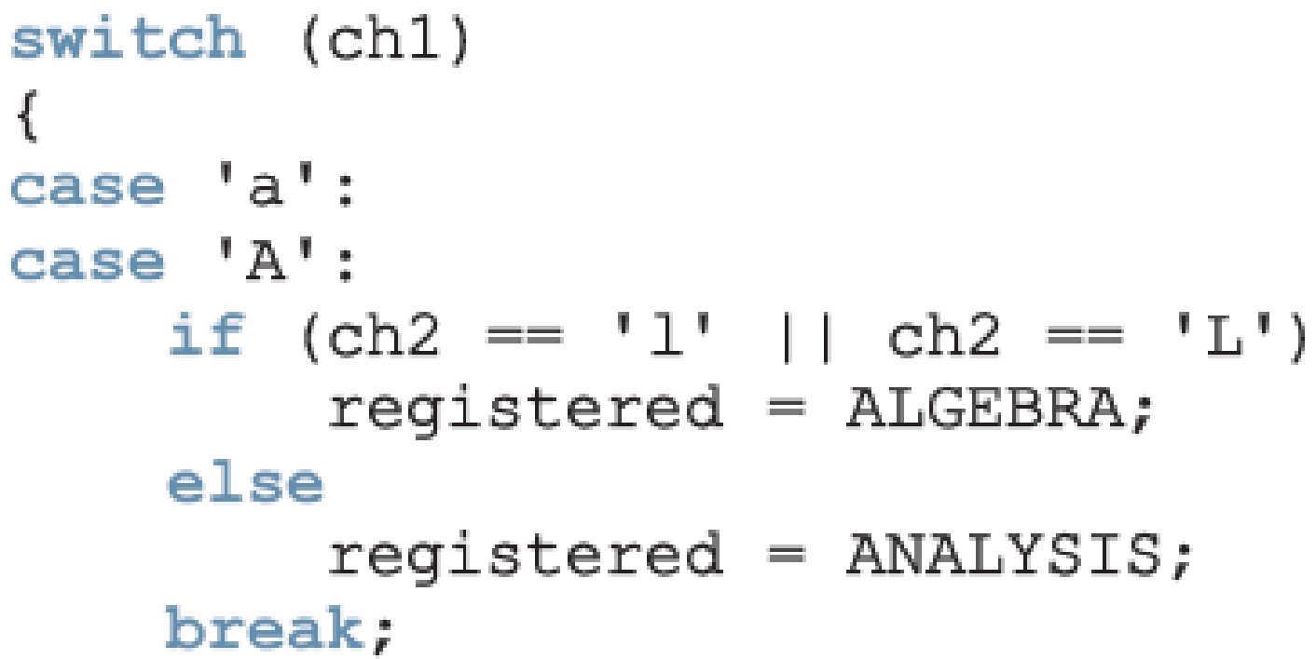
Input /Output of Enumeration Types
I/O are defined only for built-in data types
Enumeration type cannot be input/output (directly)
C++ Programming: From Problem Analysis to Program Design, Fourth Edition
‹#›

Slide 12
Functions and Enumeration Types
Enumeration types can be passed as parameters to functions either by value or by reference
A function can return a value of the enumeration type
C++ Programming: From Problem Analysis to Program Design, Fourth Edition
‹#›

Slide 13
Declaring Variables When Defining the Enumeration Type
You can declare variables of an enumeration type when you define an enumeration type:
C++ Programming: From Problem Analysis to Program Design, Fourth Edition
‹#›

Slide 14
Anonymous Data Types
Anonymous type : values are directly specified in the declaration, with no type name
Drawbacks:
Cannot pass/return an anonymous type to/from a function
Values used in one type can be used in another, but are treated differently:
C++ Programming: From Problem Analysis to Program Design, Fourth Edition
‹#›

Slide 15

typedef Statement
You can create synonyms or aliases to a data type using the typedef statement
Syntax:
typedef does not create any new data types
Creates an alias to an existing data type
C++ Programming: From Problem Analysis to Program Design, Fourth Edition
‹#›

Slide 16
Namespaces
ANSI/ISO standard C++ was officially approved in July 1998
Most of the recent compilers are also compatible with ANSI/ISO standard C++
For the most part, standard C++ and ANSI/ISO standard C++ are the same
However, ANSI/ISO Standard C++ has some features not available in Standard C++
C++ Programming: From Problem Analysis to Program Design, Fourth Edition
‹#›

Slide 17
Namespaces (continued)
Global identifiers in a header file used in a program become global in the program
Syntax error occurs if an identifier in a program has the same name as a global identifier in the header file
Same problem can occur with third-party libraries
Common solution: third-party vendors begin their global identifiers with _ (underscore)
Do not begin identifiers in your program with _
C++ Programming: From Problem Analysis to Program Design, Fourth Edition
‹#›

Slide 18
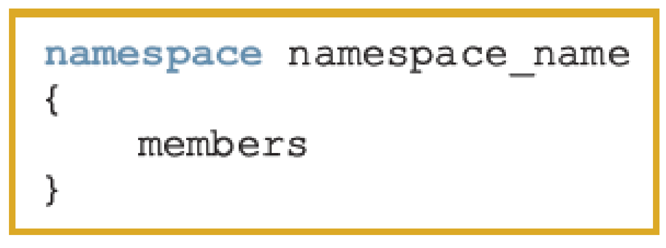
Namespaces (continued)
ANSI/ISO Standard C++ attempts to solve this problem with the namespace mechanism
Syntax:
where a member is usually a variable declaration, a named constant, a function, or another namespace
C++ Programming: From Problem Analysis to Program Design, Fourth Edition
‹#›

Slide 19
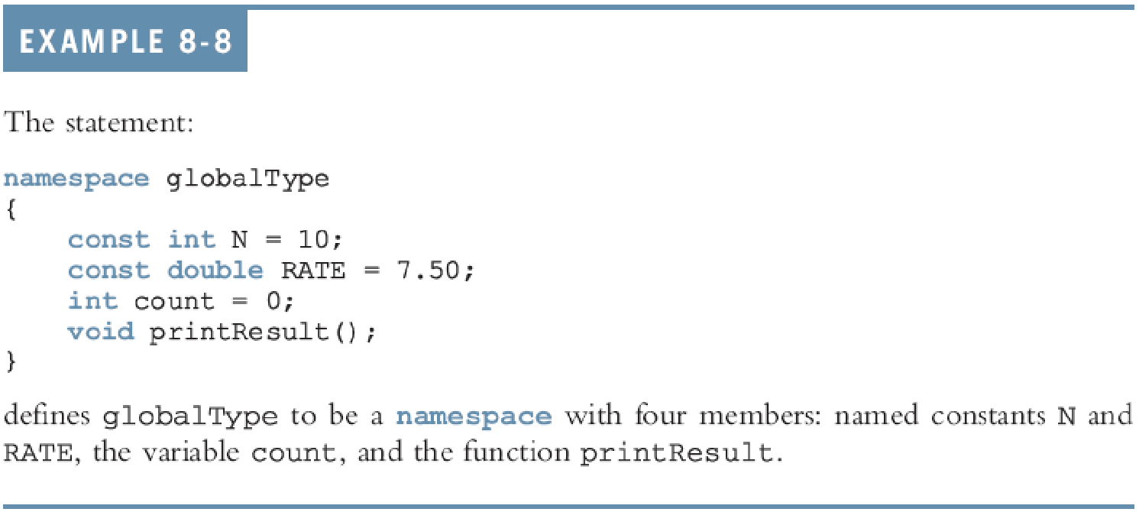
Namespaces (continued)
C++ Programming: From Problem Analysis to Program Design, Fourth Edition
‹#›

Slide 20



Namespaces (continued)
The scope of a namespace member is local to the namespace
Ways a namespace member can be accessed outside the namespace:
C++ Programming: From Problem Analysis to Program Design, Fourth Edition
‹#›

Slide 21
Accessing a namespace Member
Examples:
globalType::RATE
globalType::printResult();
After the using statement, it is not necessary to precede the namespace_name:: before the namespace member
Unless a namespace member and a global identifier or a block identifier have same name
C++ Programming: From Problem Analysis to Program Design, Fourth Edition
‹#›

